Slide 1

DATABASE FOR COMERCIAL SATELLITES
- By Sai Haresha Tirumala

Slide 2
INTRODUCTION
A database is information that is set up for easy access, management and updating. Computer databases typically store aggregations of data records or files that contain information, such as sales transactions, customer data, financials and product information
They make the work of people who want to work with data easy and more versatile, operations on the data become more operative and hands-on, filtration a very important part of managing data can be done by help of queries.
We will be working on the database that will be concentrating on the aspect of commercial satellites its sales and other aspects.

Slide 3
EXECUTIVE SUMMARY
The project aims towards creation of a database for commercial satellites, to understand their business model, Operations Model, Revenue Model. We try to understand and perform operations on few of the questions that we to understand about their business, we aim towards concentrating the operations towards the top satellite companies of the United states
We also want to understand the operations pattern towards where their sales are operated from and to, we try to concentrate on the aspects of understanding where the sales has been more and which has been the most optimum, a performance based analysis in the form of operations help us find out these aspects
Lastly we try to understand the revenue model as in which client has been profitable , which model has been profitable and which region has been profitable in terms of total revenue earned by the company.

Slide 4
COMMERCIAL SATELLITES
The commercial satellite industry has been around for over 7 decades now, this gigantic industry has generated a profit of 71.6 billion when last recorded/calculated in the year 2021.
Commercial satellite as product has been a part of many industries, revolutionizing technologies and also increasing the efficiency in user interface, US based Companies have been building or buying satellites from different manufacturing companies. Our goal is to create a database that helps us in understanding the business point of view of how these companies in different sectors have been generating profits in term of their particular uses with Commercial satellites, Our Tables/ Entities are going to be concentrated on 3 things

Slide 5
OBJECTIVE OF PROJECT
The top commercial satellite companies.
Different services rendered by these companies like Tele-communications, broadband, Direct Home television and Radio services
The different companies that they render/ Lease out their services to in the US and their Profits earned.
The Column that is uniting these tables would be the Type of services rendered, profits earned
Aim of this database is to understand the growth of monetary gain that each company was able to generate in each field and each service rendered.
Along with The operations Region and their spread throughout the country
Service requests and maintenance requirements reached by each company and client
The project is considered to be only a small part of the total big database that we tend to replicate

Slide 6
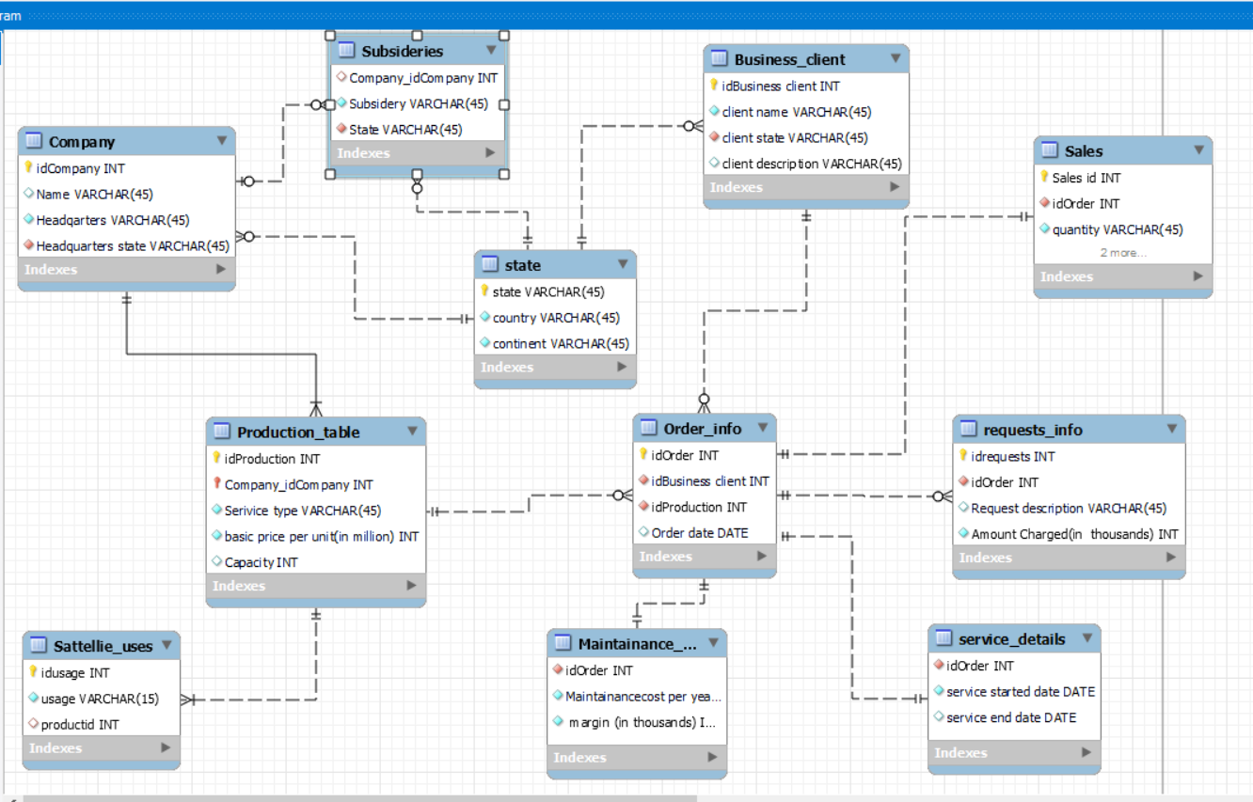
Entity Relationship Diagram

Slide 7
Questions addressed
2). display the continent and country of all the companies that have subsidiaries ? 2)Looking up clients who have ordered
3)Looking up for clients who made requests
4)Looking up for id’s of production whose margin is greater than or equal to 100 million
5)Looking up company’s headquarters continent
6)Looking up for company id’s who provide multiple services
7)Displaying total cost for each year including maintenance cost
.8)Grouping above results by clientid and storing in another table totals1
9)Grouping the request charges per order and storing in table create table requests_per_order
10)Displaying total cost including request charges for each clientid
11)Displaying client name along with the total charges spend by them
12)Displaying margin for maintenance and margin for ordering for each order.
13)Displaying the month, the service ended
14)Displaying details of companies who have subsidiaries
15)Displaying companies who provide fixed services
16)Displaying product details whose capacity> 5 and used or televisions
17)Displaying clients whose ordered in 2017 and 2018
18)Displaying clients who are in headquarters state of any company
19)Displaying clients who ordered more than 2 units
20)Displaying clients who spent more than 1 Billion

Slide 8
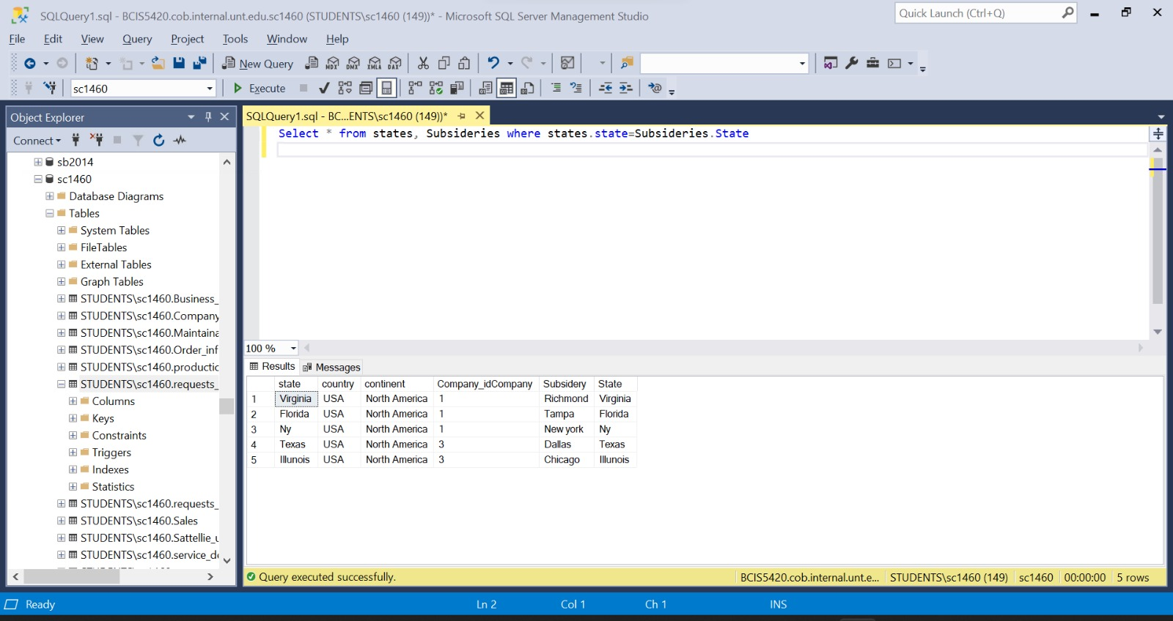
Sample query
Q1. display the continent and country of all the companies that have subsidiaries ?
Ans- Select * from states, Subsideries where states.state=Subsideries.State

Slide 9
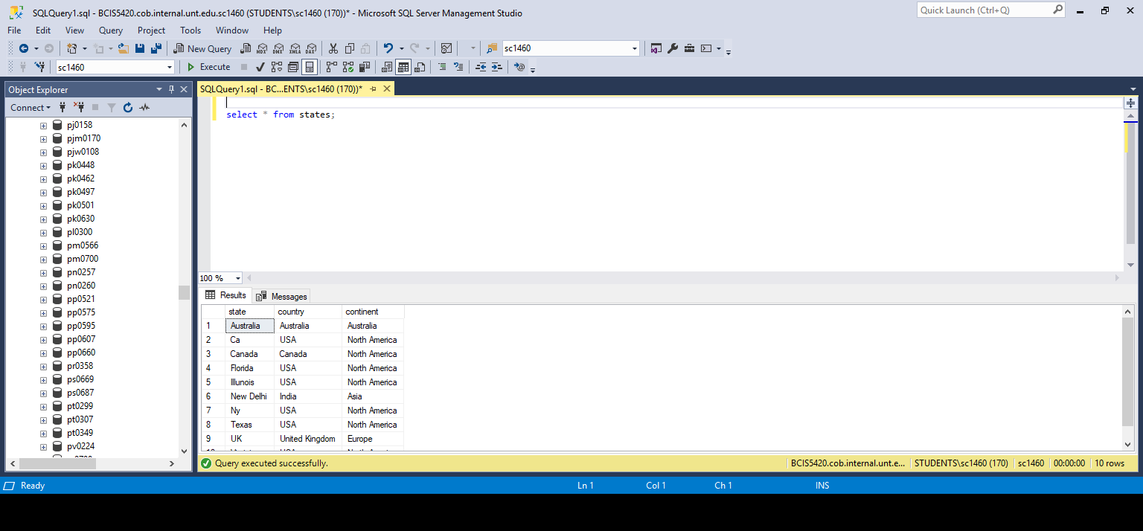
Table 1.1 State

Slide 10
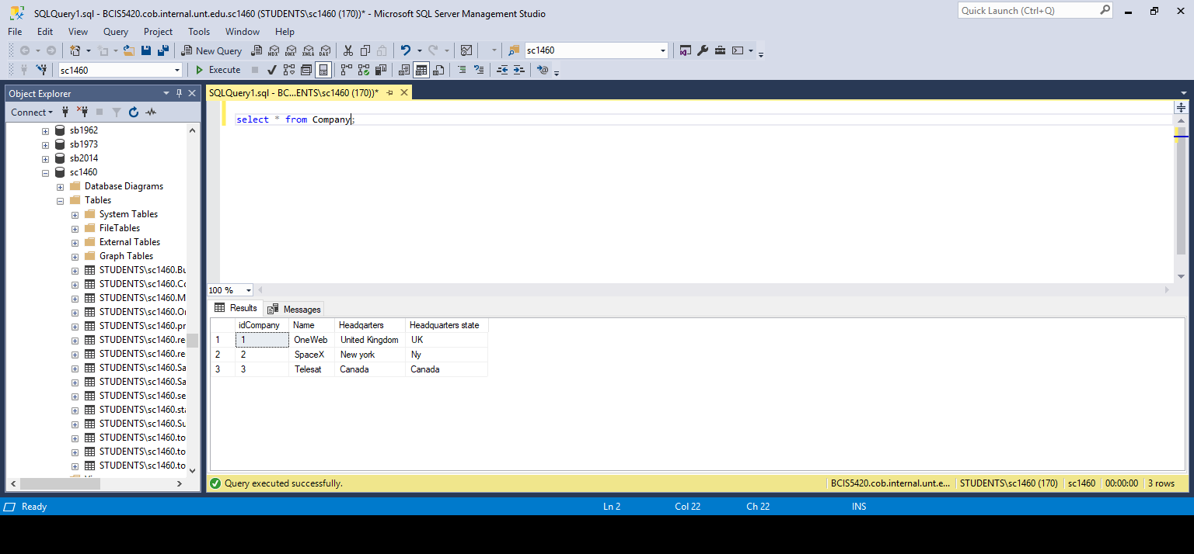
Table 1.2 Company

Slide 11
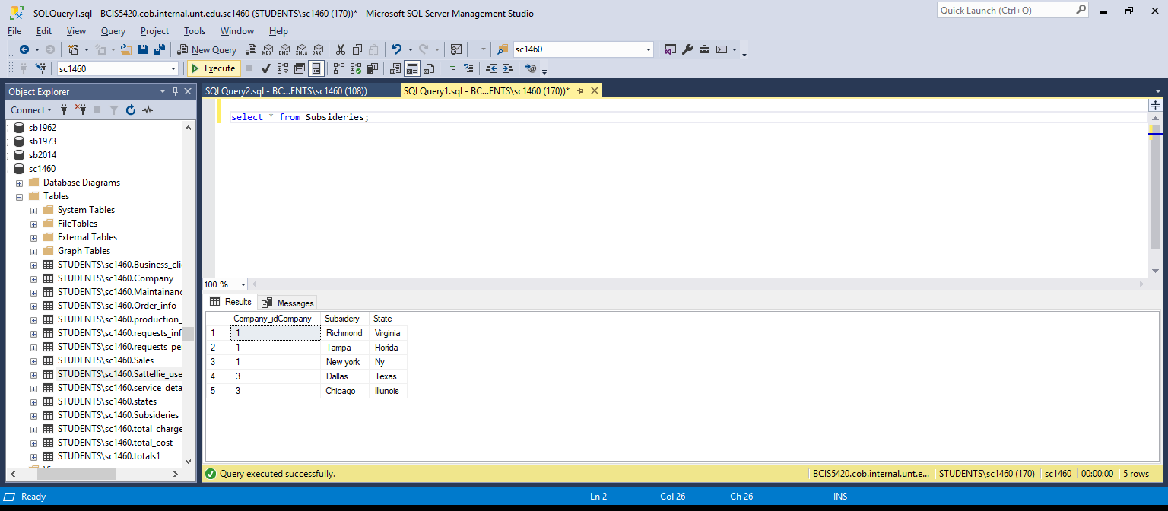
Table 1.3 Subsidiaries

Slide 12

Table 1.4 Production

Slide 13
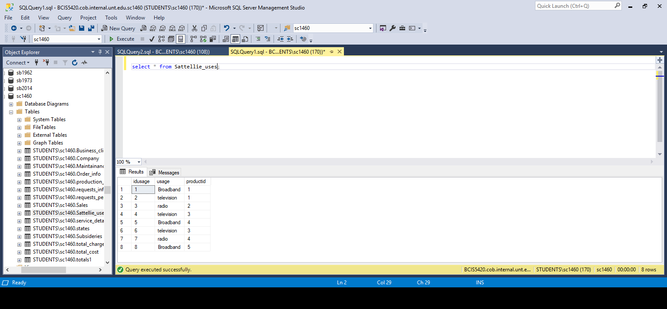
Table 1.5 Uses

Slide 14
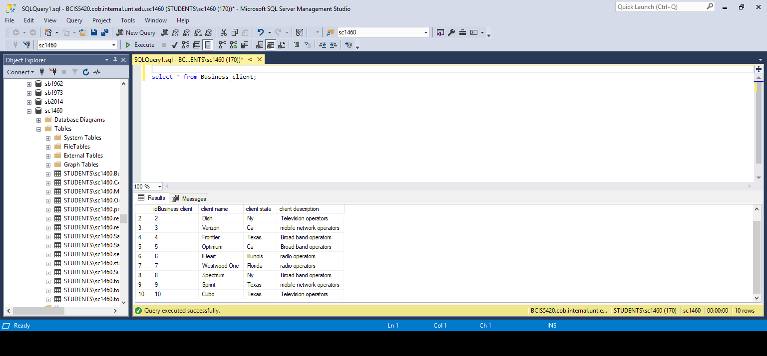
Table 1.6 Business Client

Slide 15
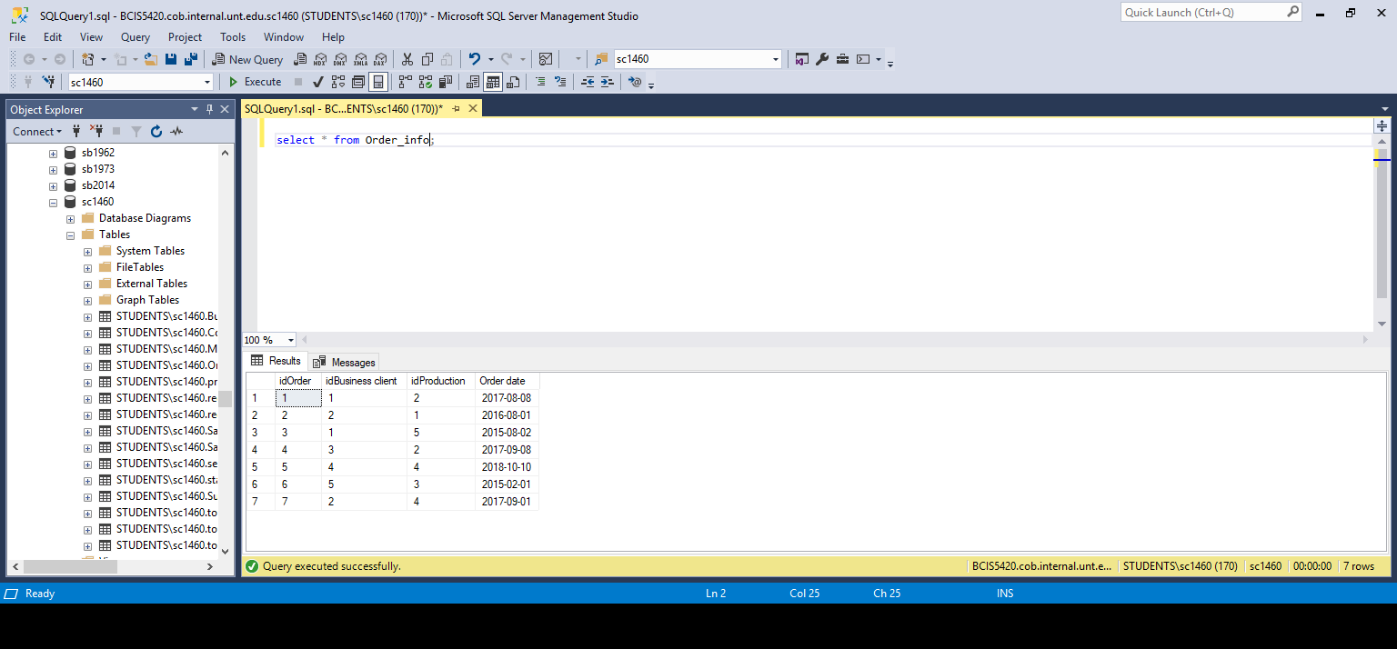
Table 1.7 Order

Slide 16
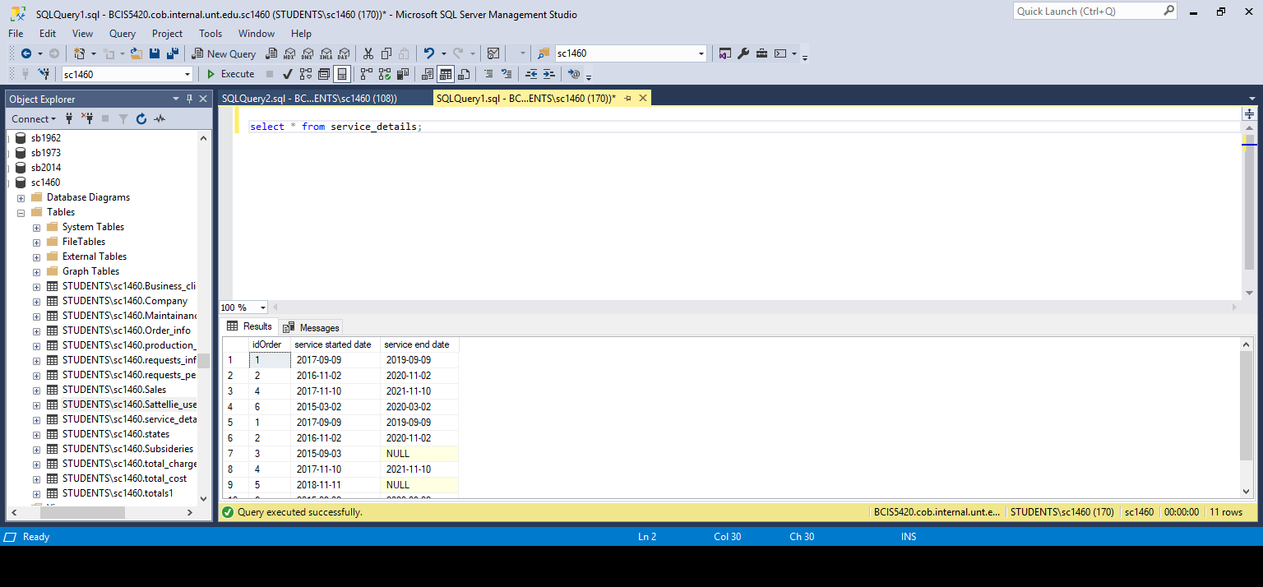
Table 1.8 Service Details

Slide 17

Table 1.9 Maintenance

Slide 18
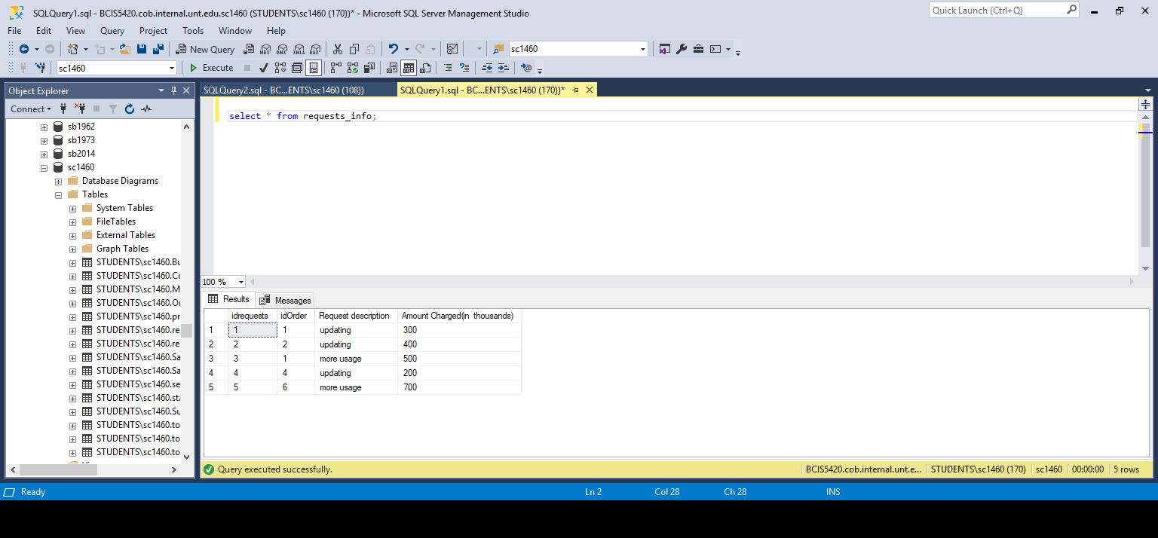
Table 1.10 Request Info

Slide 19
Conclusion
The Ideology that we have tried to replicate is that if the commercial satellite industry had a database what would have been our areas of interest in the terms of questions and query’s
We have tried to involve and combat issues that have arrived in terms of service and maintenance requests
The understanding and involvement in-terms of region and country with respect to headquarters, profits, sales and Requests.

